Slide 1




Partner Opportunity
Overview
Solutions for Performance Driven Companies
Microsoft Enterprise Open Source Solutions

Slide 2
Agenda
Introductions
Aras PowerPoint (30 minutes)
  Company Background
  Business Model
  Solution Suite and Technology Overview
Demonstration (30+ minutes)
  Aras Innovator Out-of-The Box Feature/Function
  Aras Model-Based SOA Technology Platform
Questions / Discussion
Slide <number>

Slide 3

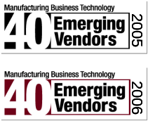

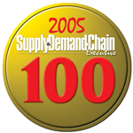




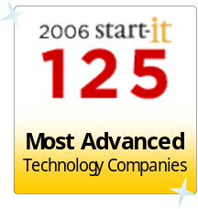
Aras Company Overview
Business: Enterprise Open Source PLM
  NPDI New Product Development & Introduction
  CMII Configuration & Change Management
  APQP Advanced Product Quality Planning
  PDM Product Data Management
  BPM Business Process Management
  EQM Enterprise Quality Management
Product: Aras Innovator ®
Technology: Model-Based SOA on .NET
Certifications:
Slide <number>

Slide 4




















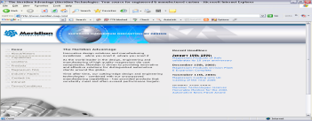














Reference Customers
SMB to Enterprise
  5 seats at Brijot to 5,000 at Lear Auto
Verticals
  A&D
  Auto
  Consumer Goods
  Industrial Equipment
  Med Devices
New Era Ohio, LLC
Slide <number>

Slide 5
Business Model
Enterprise Open Source (like Red Hat )
  Enterprise Business Software Category
  No Software License Fees - Openly Distributed Software
  Revenues from Support Subscriptions, Training, and Consulting
Enterprise Open Source vs. Open Source
  Corporate Community vs. Academic Community
  Microsoft PL vs. the GPL (no restrictions or obligations)
  Distributed as a Microsoft-certified binary installer
  90% of core source code is developed / maintained only by Aras
  Integrations, Solutions, Add-On’s from Partners and End-users
  Aras distributes as Open Source, but we do not use Open Source
Slide <number>
Slide <number>

Slide 6
Business Model
Profitable Business Model
  Predictable Recurring Revenues
  No Sales Staff, No Cost of Sales
  Low Cost Web-based Marketing
  70% of Employees are Engineers working on Product
Growth Model
  60% Annual Growth in Revenues -- 2007 and 2008
  World-Wide Certified Support and Training Centers
    United States, Japan, Taiwan, Israel, UK, France, South Africa, Germany, Switzerland, Turkey, South Africa, Shanghai, Norway, Sweden, Canada, Singapore, & Russia
  ~ 300 Installations per Month
Slide <number>
Slide <number>

Slide 7
Business Model
Subscription
  Live Hotline
  Microsoft Certified Versions
  Security Patches / Hot Fixes / Monthly Service Packs
  Productivity Tools
  Free Training
  Software IP Indemnification
  Unlimited Upgrade Services
Slide <number>
Slide <number>

Slide 8










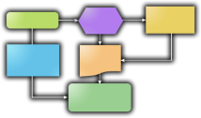








PLM Solution Map
Concept
Design
Development
Launch
Manufacture
Support
Phase-based Program Management
CAD
Document Mgt
File Vault
CMII Change Mgt
ERP
“The Void”
No Visibility
No Repeatable Processes
Not Lean
Quoting Process
Requirements
&
Specifications
BOMs & Parts
AVL / AML
Qualified
Suppliers
Part
Approval
Reports &
Dashboards
FMEA
Process Flows
Control
Plans
CAPA
Corrective Actions
Slide <number>

Slide 9


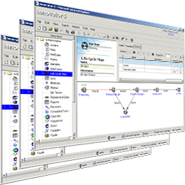



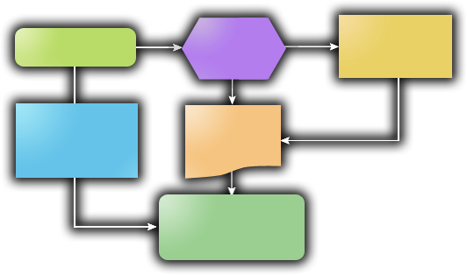


Aras Enterprise Solutions
Aras Program Management
Phase-Gate Projects
Milestones & Deliverables
Traffic Light Risk Dashboards
PMI Project Templates
Enterprise Open Source Solutions
Download Includes:
  Program Management
  Product Engineering
  Quality Planning
Aras Product Engineering
Bill Of Materials [BOM], Product SKUs
File & Document Management
Change Management Workflows
Approved Vendor Lists [AVL/AML]
Community Solutions:
  Corrective & Preventive Actions
  Environmental Compliance
  Training & Skills Tracking
  Customer Quoting
  RFP Management
  Dashboards & Scorecards
  Tooling and Fixtures
  Mfg Process Planning
Aras Quality Planning
Risk Management
Failure Mode Effects Analysis [FMEA]
Control Plans
Action Item Closed-Loop
Slide <number>

Slide 10





Model Based SOA
Conventional Systems
Aras Innovator
Model-Based SOA
Client
Client
Compiled Logic
Fundamentally
Different
XML Solution Models
Server Code
Web Services SOA
Files
Database
Files
Database
Flexibility
Graphical Drag & Drop Real-Time Changes Without Complex Programming
Benefits
Upgradeability
Technology Separation Enables Quick & Easy Upgrades Without Impacting Customizations
Slide <number>

Slide 11







Model Based SOA
Web Interface
Other Clients
Solution Studio
Reporting
Business Logic
Outlook
Word
Excel
Project
SharePoint
Microsoft
Reporting
Services
Web Parts
.NET UI Components
Innovator Object Model
X M L / S O A P
Client Side
Server Side
Web Services
Business Logic
Business Objects & Processes
XML/SOAP
Web Services
Meta Data Management
Workflow Services
Classification Services
Search Services
Security Services
Lifecycle Services
Federation Services
Configuration Services
Event Services
Vaulting Services
Data Access Components
.NET Integrations
ADO
ODBC
Flat File
Direct API
O-R Mapping
Transaction Mgt
Cache
BizTalk Server
ADO.NET Data Access
Database
Web Services
Business Logic
Aras File Vault
Business Objects & Processes
MOSS
Microsoft Office
SharePoint Services
Object Definitions
Process Definitions
SharePoint
File Library
System Definition
Slide <number>

Slide 12
Partner Models
Systems Integrator
  Sells consulting and training services
  Optionally: Re-sells Aras Subscriptions for margin
  20%-45% depending on level of Support provided
ISV
  Add-on products distributed through the Aras Community
  Optionally: software licenses fees or subscriptions
OEM
  Bundles Aras Model-Based SOA with their Product
  Provides 1st and 2nd level support
  Pays % of maintenance revenue to Aras
Slide <number>
Slide <number>

Slide 13


Partner Benefits
  Microsoft Enterprise Open Source Benefits
  Removes Customer’s Up-front Capital Barrier
  Saves Client Budget for Partner Services
  Enables Partners to Install PLM Solutions
  for Future Projects without Up-Front Expenses
  Leverages Low-Cost Web Marketing Techniques
  Partner Benefits
  Simple Partnering Structure
  Partner is Productive Quickly
  Aras Corp Distributes all Leads
  No Cost to Join Program
  Building and Selling Add-ons is Encouraged
Slide <number>
Slide <number>

Slide 14















Enterprise Open Source
Sales Process
Structured Path to Close
Interest
Qualification
Services
Support
Lead
Prospect
Customer
Support
Subscription
Downloads
Clear Criteria
Business Initiative
Project Champion
Technical Resource
Package
Proof =
PO
Proof =
Project
Definition
Consulting
Training
Multi-Year Contracts
+ Follow-on Service
Engagements
Aras Investment
Partner Investment
Partner Revenue…
Google Ads
Email Campaigns
Blogs & PR
Telemarketing Calls
WebEx Demos
Installation Support
Project Scoping
Workshops
training
Pilots
Deployments
Business Consulting
Account Control
Slide <number>
Slide <number>

Slide 15
Product Tour
Aras Innovator Easy-to-Learn
  User Experience
  User Interface
Solutions Easy-to-Use
  Program Management
  Product Engineering
  Quality Planning
Administration Easy-to-Change
  Item changes
  Form changes
  Process changes
Slide <number>

Slide 16
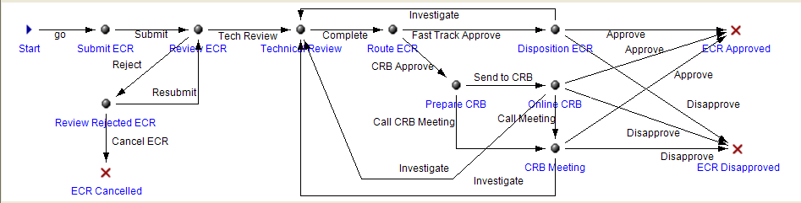
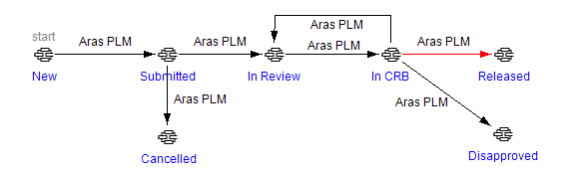
Project - Workflow - Lifecycle
5C
Workflow Activity
People
Short Activities
Email Notifications
ECN 123456
Description
Effectivity
Originator
…
Lifecycle State
Permissions
Integration Events
CM Behaviors
Email Notification
Slide <number>

Slide 17
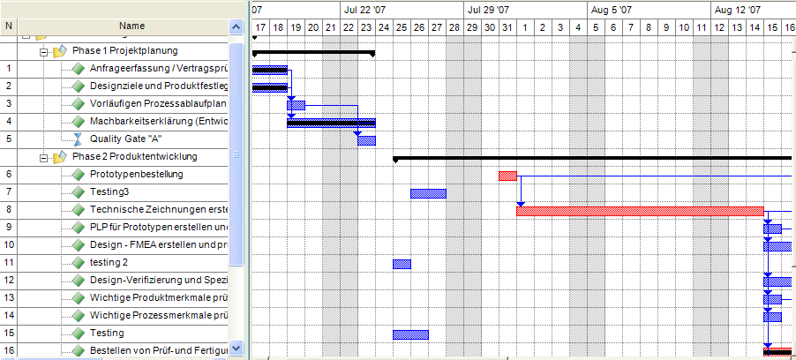
Project - Workflow - Lifecycle
5C
Project WBS
Resource Planning
Long Activities
Scheduling
Many Deliverables
Email Notifications
Part AAG
Description
Effectivity
Originator
…
CAPA 893
Description
Effectivity
Originator
…
Workflow Activity
ECN 13456
Description
Effectivity
Originator
…
Lifecycle State
Slide <number>

Slide 18

3
Platform Sizing
Single Server for Initial Deployment / Small Scope
    ~ 200 users
Multiple Servers for scalability
    ~ 500 users
Distributed Servers for performance over
the corporate WAN and large scale
deployments.
Site 3
Innovator Client Cache
Web Server
Site 1
Site 2
Innovator Server
Aras Vault Server
Aras Vault Server
Innovator Server
Aras Vault Server
HQ
SQL Server
SQL Server
Innovator Server
Single Server:
Innovator Server
Vault Server
SQL Server
Multiple Servers:
Innovator Server
Vault Server
SQL Server
Distributed Servers:
Innovator Server(s)
Vault Server(s)
SQL Server
Slide <number>

Slide 19
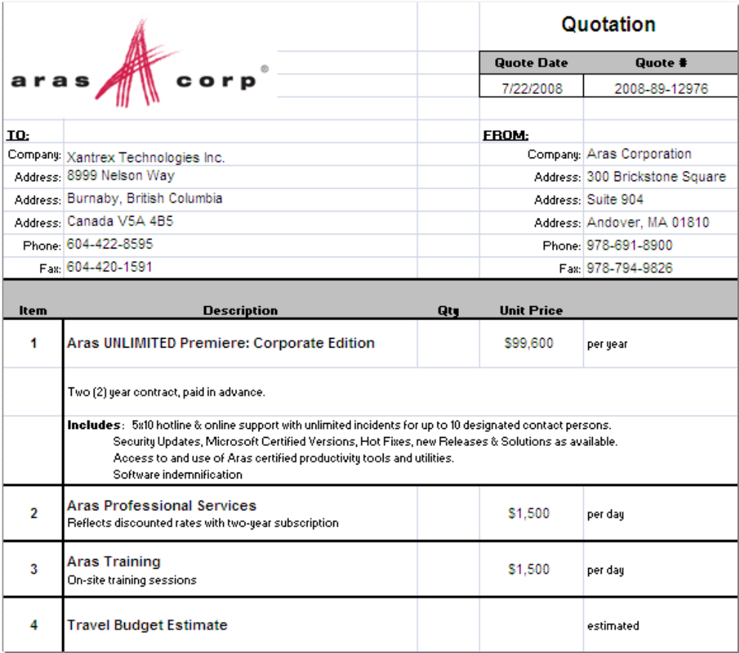

Example Quote
Subscription
(a.k.a. Maintenance)
Professional Services
Training
Travel & Exp Est.
Slide <number>
Slide <number>

Slide 20
Customer Case Studies
Slide <number>

Slide 21
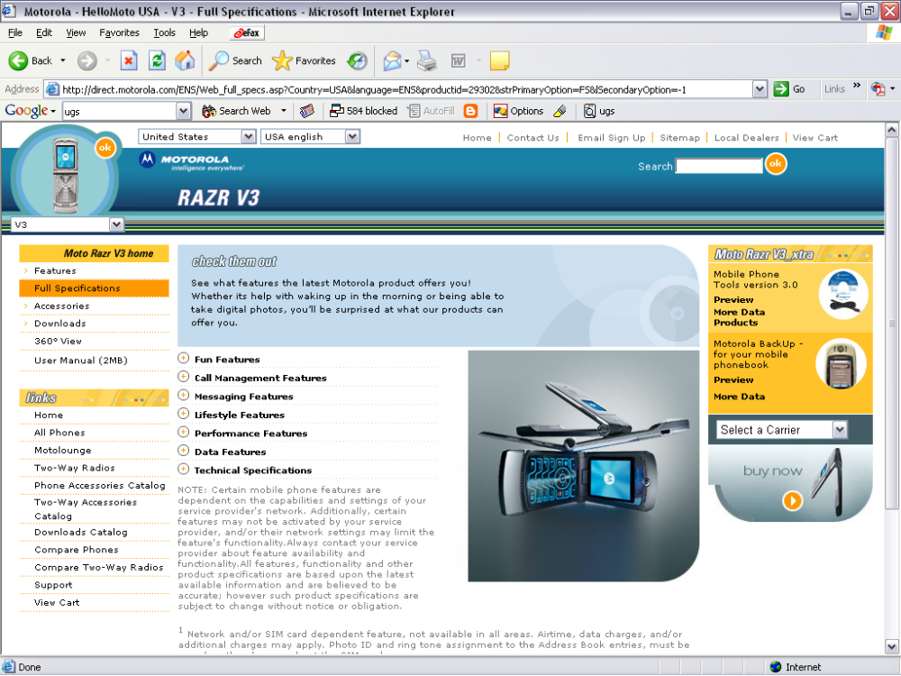
Aras in Action
Company:
Applied Technology – Schaumberg
Products:
Next-Gen Electronics & Materials
Markets:
Communications & High Tech
Customers:
Government & Other Motorola Divisions
Challenge:
Coordinate new product development to manage growth and secure product information to protect IP
Solution:
Aras for Program Project Management
Results:
Improved Project Management and Risk Mitigation with IP Secure & Controlled
Business Profile
Business Case
Slide <number>

Slide 22



Aras in Action
Company:
Lockheed Martin – Naval Systems & Surveillance
Products:
Advanced weapons systems
Markets:
Naval Military Programs – VLA
Customers:
Department of Defense
Challenge:
Manage complex Manufacturing Bills of Materials [MBOM] with Routings, Work Centers, Lean Procedures, Tooling
Solution:
Aras for Manufacturing Process Planning
Results:
Achieves control for better planning and production execution reducing scrap & rework and improving productivity
Business Profile
Business Case
Slide <number>

Slide 23

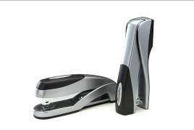
Aras in Action
Company:
ACCO Swingline
Products:
Staplers, Hole Punches
Markets:
Consumer Products
Customers:
Wal*Mart, Staples, Office Depot
Challenge:
Development Process Coordination for New Product Programs
Solution:
Aras for New Product Development & Introduction [NPDI]
Results:
On-time Brand Introduction and Control over IP with Outsource Partners in China
Business Profile
Business Case
Slide <number>

Slide 24
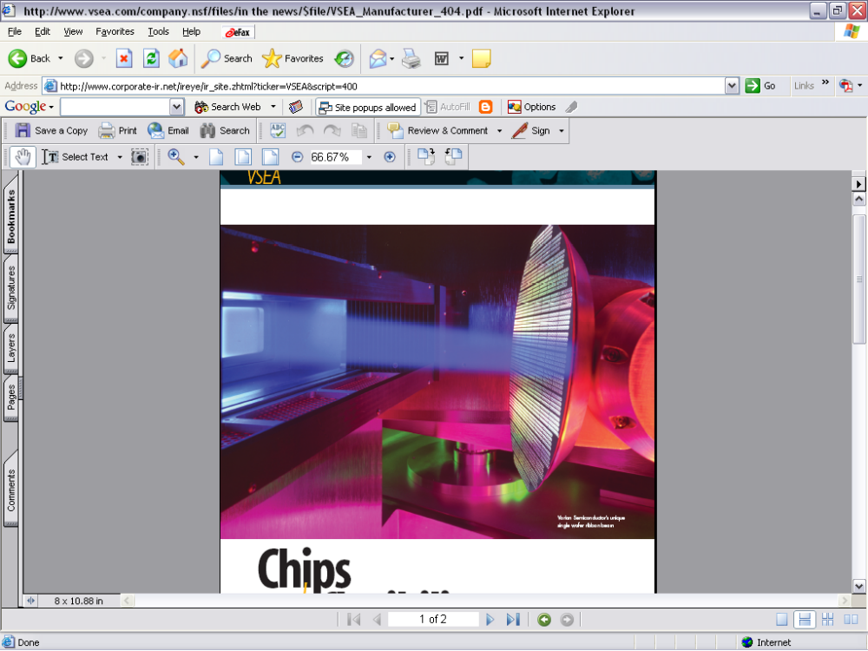

Aras in Action
Company:
Varian Semiconductor Equipment
Products:
Ion Implant Equipment
Markets:
Semiconductor Fab
Customers:
TSMC, Intel, Samsung, IBM
Challenge:
Complex Engineering Changes with Information in Multiple Systems and Need to Reducing Cycle Times with CMII
Solution:
Aras for Product Engineering [CMII]
Results:
Process Workflow Integrates Various Systems providing Visibility and Faster Change Management for CMII
Business Profile
Business Case
Slide <number>

Slide 25


Aras in Action
Company:
Mega Brands
Products:
Construction Building Toys
Markets:
Consumer Products
Customers:
Wal*Mart, Toys R Us, Target
Challenge:
Design to Cost Targets while maintaining Quality Levels for New Product Intro [NPI]
Solution:
Aras for New Product Development & Introduction [NPDI]
Results:
On-time, On-cost, High-quality
New Product Launches
Business Profile
Business Case
Slide <number>

Slide 26


Aras in Action
Company:
L-3 Ocean Systems
Products:
Precision Sonar
Helicopter Long Range Active Sonar (HELRAS) and Advanced Side Looking Sonar (ASLS)
Markets:
Commercial & Military Programs
Customers:
Department of Defense
Challenges:
Manage complex Manufacturing Process Plans with Production Lines, Lean Method Sheets, Set-up Instructions, Tooling
Solution:
Aras for Manufacturing Process Planning
Results:
Better pre-production planning and Lean Six Sigma processes for improved productivity and control
Business Profile
Business Case
Slide <number>

Slide 27


Aras in Action
Company:
Ogihara America Corporation
Products:
Class A Vehicle Body Parts
Markets:
Automotive Supplier
Customers:
GM, Ford, Mitsubishi, Nissan
Challenge:
Resolve Customer Issues, Nonconforming Material Tracking, and Corrective & Preventive Actions
Solution:
Aras for 5-phase 8D CAPA
Results:
CAPA Workflow Integrates with ERP providing Closed-loop Resolution for Rapid Response to Quality Issues
Business Profile
Business Case
Slide <number>

Slide 28

Aras in Action
Company:
Thermal & Interiors
Products:
Designs & manufactures advanced steering, cooling & interior systems
Markets:
Automotive Supplier
Customers:
GM, Ford, DCX, Renault/Nissan
Challenge:
Needed Risk Management for Customer Compliance and Deliverables
Solution:
Aras for Quality Planning & Risk Management
Results:
Reduced Product Risks and Improved Quality while better managing
Customer Compliance Deliverables
Business Profile
Business Case
Slide <number>

Slide 29


Aras in Action
Company:
Freudenberg-NOK
Products:
Designs and manufactures gaskets & isolation mounts
Markets:
Automotive Supplier
Customers:
GM, Ford, DCX, Nissan
Challenge:
Manage APQP compliance and customer-specific requirements while improving new product launch success
Solution:
Aras for APQP
Results:
Ensures APQP compliance and customer deliverable accuracy and achievement of flawless launch program
Business Profile
Business Case
Slide <number>

